Slide 1
Harnessing User Feedback Analysis Using Power BI
Enhancing Product Design with App Review Insights

Slide 2
Introduction
User feedback is often unstructured and underused.
Manual review is slow and not scalable.
Power BI enables clear visualization of user sentiment and behavior.

Slide 3
Research Aim & Objectives
Aim: Turn app reviews into product design insights.
Clean and prepare user feedback data.
Create Power BI dashboards to visualize sentiment.
Help teams find areas needing improvement.

Slide 4
Research Questions
How can Power BI turn raw feedback into insights?
What visualizations best show sentiment?
How does sentiment relate to product updates?
What are Power BI’s limits for feedback analysis?

Slide 5
Methodology Overview
Case study using Google Play Store reviews.
Cleaned data with Python in Google Colab.
Analyzed and visualized in Power BI.
Built sentiment-tagged dashboards.

Slide 6
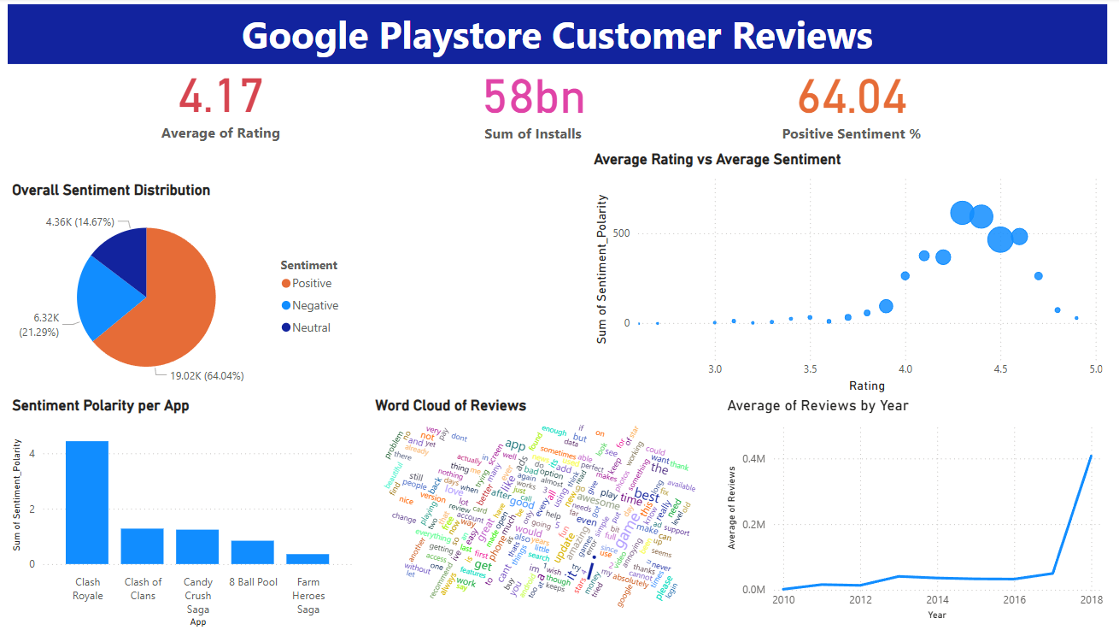
Power BI Dashboard Snapshot

Slide 7
Insights from Dashboard
64% of reviews were positive.
Most installs from Communication & Entertainment apps.
Some apps had high ratings but low sentiment.
Frequent keywords: “easy,” “crash,” “ads,” “love.”

Slide 8
Limitations
Power BI lacks native NLP/text mining.
Requires external sentiment processing.
Word clouds are basic.
Visuals are based on static, not real-time, data.

Slide 9
Conclusion and Future Work
Power BI helps visualize user feedback clearly.
Great for product managers without coding skills.
Future work: add real-time streaming and advanced visuals.

